Slide 1
AI In Agriculture
Transforming Farming with Artificial Intelligence
6253-ITAI-2372 - Alfredo, Ola, Khizar, Richard

Slide 2
Table of contents
01
02
03
04
05
Domain Overview & Importance
AI Use Case Motivation
Real-World Examples
06
AI Techniques Used in Agriculture
Key Applications (Case Studies)
Impacts & Benefits
07
08
09
Challenges & Risks
Demo
Conclusion

Slide 3
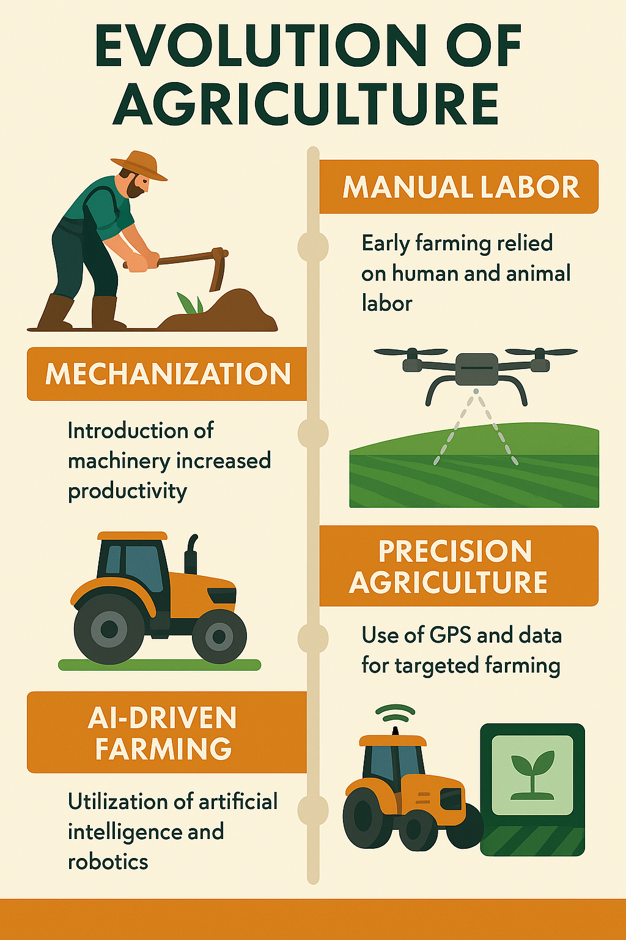
Domain Overview & Importance
What is Agriculture?
Agriculture is the science and practice of cultivating plants and livestock for food, fiber, and other products. It is one of the oldest industries, evolving from manual labor to mechanized farming.
Why It Matters:
Global Food Demand: With a growing population, food production must increase efficiently.
Climate Change: Unpredictable weather patterns affect crop yields.
Sustainability: AI helps optimize resources like water and fertilizers.

Slide 4
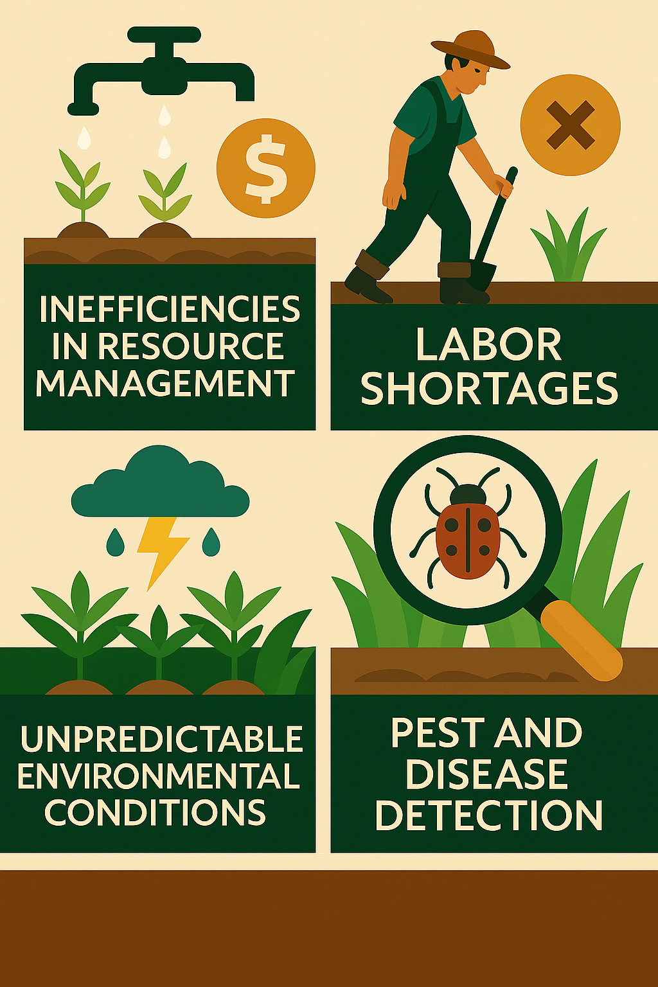
AI Use Case Motivation
Problems Being Solved:
Inefficiencies in Resource Management: Farmers often struggle with optimizing water, fertilizers, and pesticides, leading to waste and environmental harm.
Labor Shortages: The agricultural sector is experiencing a decline in available workforce, making automation essential.
Unpredictable Environmental Conditions: Climate change has made weather patterns more erratic, affecting crop yields and farming schedules.
Pest and Disease Detection: Early identification of plant diseases and pests is crucial to prevent large-scale crop loss.

Slide 5
Real-World Examples
AI-Powered Drones for Crop Monitoring
Smart Irrigation System
Drones equipped with AI and multispectral imaging analyze crop health in real time.
They detect early signs of disease, nutrient deficiencies, and pest infestations.
Farmers receive actionable insights, allowing them to intervene before damage spreads.
Example: PrecisionHawk uses AI-driven drones to assess crop health and optimize yields.
AI-powered irrigation systems use sensors to monitor soil moisture and weather conditions.
Machine learning algorithms predict optimal watering schedules, reducing water waste.
Example: Arable Labs provides AI-driven irrigation solutions that improve water efficiency.
Automated Pest Control
AI-driven robots and IoT sensors detect pests and apply targeted treatments.
This reduces pesticide use and minimizes environmental impact.
Example: Blue River Technology’s See & Spray system identifies weeds and applies herbicide only where needed.

Slide 6
AI Techniques Used in Agriculture
Computer Vision
Machine Learning
Robotic & Automation
How It Works: AI-powered cameras and sensors analyze images of crops to detect diseases, pests, and nutrient deficiencies.
Ways Computer Vision is being used:
Pest & Disease Detection: AI models identify early signs of plant diseases using image recognition.
Weed Control: AI-driven sprayers target weeds precisely, reducing herbicide use.
Livestock Monitoring: AI cameras track animal health and behavior.
Example: Taranis uses high-resolution aerial imagery to detect crop diseases before they spread.
How It Works: AI algorithms analyze historical data, weather patterns, and soil conditions to predict optimal planting times and expected crop yields.
Ways machine learning is applied:
Yield Prediction: AI forecasts harvest outcomes based on environmental factors.
Smart Irrigation: AI adjusts water usage based on soil moisture levels.
Supply Chain Optimization: AI predicts market demand and pricing trends.
Example: AI-driven precision agriculture platforms help farmers optimize planting schedules.
How It Works: AI-powered robots and autonomous machines perform farming tasks with minimal human intervention.
Ways Robotics and Automation are applied:
Autonomous Tractors: AI-driven tractors plow fields and plant crops.
Automated Harvesting: AI robots pick fruits and vegetables efficiently.
Drone-Based Spraying: AI-powered drones distribute fertilizers and pesticides.
Example: John Deere’s autonomous tractors use AI to optimize farming operations.

Slide 7
Key Applications (Case Studies)
IBM Watson Agriculture
Blue River Technology – Smart Weed Control
IBM Watson Agriculture leverages AI to help farmers make data-driven decisions. The Watson Decision Platform for Agriculture integrates AI, IoT, and cloud computing to analyze environmental data, predict crop yields, and optimize farming practices. Farmers can use Watson’s image recognition to detect diseases and pests early, improving crop health and reducing losses.
Blue River Technology, a subsidiary of John Deere, developed See & Spray™ technology, which uses computer vision and machine learning to identify weeds and apply herbicide only where needed. This precision agriculture approach reduces chemical usage, lowers costs, and minimizes environmental impact.
John Deere AI Tractors – Autonomous Farming Equipment
John Deere is pioneering autonomous tractors that use AI, GPS, and computer vision to perform tasks like tillage without human intervention. These tractors optimize efficiency, reduce labor dependency, and improve precision in farming operations.

Slide 8
Impact & Benefits
Quantified Success:
Improved crop health monitoring: AI-powered satellite imagery and drone monitoring have reduced crop losses by up to 30%, saving farmers thousands per season.
Reduced Environmental impact: AI-driven precision agriculture has reduced water usage by up to 35%, significantly lowering irrigation costs.
Social & Economic Impact:
Lower costs for farmers:
AI adoption has led to a 22-31% reduction in annual operating costs for farms using autonomous equipment and precision agriculture.
Increased food security:
AI-powered predictive analytics have improved yield forecasting accuracy by 85-90%, helping farmers plan better

Slide 9
Challenges & Risks
1. High Costs & Investment
AI-powered farming equipment, sensors, and software require significant upfront investment.
Many small-scale farmers struggle to afford AI technologies, limiting adoption.
Maintenance and upgrades add to long-term costs.
2. Lack of Technical Expertise
AI requires specialized knowledge in data science, machine learning, and automation.
Farmers may lack the training to operate AI-driven tools effectively.
Hiring AI experts can be expensive and impractical for smaller farms.
3. Connectivity & Infrastructure Issues
Many rural areas lack stable internet access, making cloud-based AI solutions difficult to implement.
AI-powered devices often require high-speed data processing, which may not be available in remote farming regions.
4. Data Privacy & Security Concerns
AI relies on large amounts of agricultural data, raising concerns about ownership and security.
Farmers worry about data misuse by corporations or third parties.
Regulations on AI-driven data collection are still evolving.

Slide 10
Challenges & Risks (cont’d)
5. Resistance to Change
Traditional farmers may be skeptical about AI replacing manual farming methods.
Some fear job displacement due to automation.
Adoption rates are slow due to uncertainty about AI’s long-term benefits.
6. Regulatory & Ethical Challenges
Governments are still developing policies for AI adoption in agriculture.
Ethical concerns arise regarding fair AI decision-making in farming.
AI-driven automation may impact labor markets, requiring new regulations.
7. Environmental & Sustainability Issues
AI models need large datasets, which may not always be available for sustainable farming.
Some AI-driven solutions increase energy consumption, raising environmental concerns.

Slide 11
Future Directions
Emerging Trends:
Multimodal AI for better predictions by integrating multiple data sources—such as satellite imagery, sensor data, and weather forecasts—to improve agricultural predictions.
Federated learning allowing multiple farms to train AI models collaboratively without sharing raw data, ensuring privacy and security.
Innovations:
AI-driven climate adaptation strategies, these AI models will help farmers adapt to climate change by predicting extreme weather events and optimizing crop selection. This is done by using historical climate data to forecast droughts, floods, and temperature shifts.

Slide 12
Demo
https://youtu.be/OHOexrYlz7E?si=phpBtaHuK7uZpUdt

Slide 13
Conclusion
Artificial Intelligence is transforming agriculture by enhancing efficiency, sustainability, and productivity.
Optimized Resource Management: AI-driven irrigation and fertilization systems reduce waste and improve crop health.
Improved Yield Predictions: Machine learning models analyze weather patterns and soil conditions to forecast harvests.
Automated Farming: AI-powered robots and autonomous tractors streamline labor-intensive tasks, addressing workforce shortages.
Precision Agriculture: Computer vision detects diseases and pests early, minimizing crop loss and reducing pesticide use.
Challenges: Despite its benefits, AI adoption faces hurdles such as high costs, data privacy concerns, and regulatory uncertainties.

Slide 14
Final Thought
The Future of Farming is AI-Driven
The agricultural industry is at a turning point, where AI is no longer a luxury but a necessity.
As AI continues to evolve, farmers will rely on intelligent systems to make data-driven decisions, ensuring food security for a growing population.
Innovations like multimodal AI, federated learning, and climate-adaptive algorithms will shape the next generation of farming.
The integration of AI with IoT, robotics, and blockchain will create a more transparent, efficient, and sustainable agricultural ecosystem.
AI is not replacing farmers—it’s empowering them to cultivate smarter, more resilient farms. The future of agriculture is precision-driven, sustainable, and AI-powered

Slide 15
References & Acknoledgements
https://newsroom.ibm.com/IBM-watson?item=30660
https://www.bluerivertechnology.com/our-products/
https://www.farmprogress.com/weeds/smart-sprayers-already-here-or-coming-soon
https://www.cnbc.com/2022/10/02/how-deere-plans-to-build-a-world-of-fully-autonomous-farming-by-2030.html
https://builtin.com/artificial-intelligence/ai-in-agriculture
https://www.omdena.com/blog/top-6-ai-case-studies-in-agriculture
https://www.forbes.com/sites/ganeskesari/2024/03/31/the-future-of-farming-ai-innovations-that-are-transforming-agriculture/
https://intellias.com/artificial-intelligence-in-agriculture/
https://www.ark-invest.com/articles/analyst-research/will-the-convergence-between-artificial-intelligence-and-precision-agriculture-lower-farming-costs
https://scryai.com/use-cases/agriculture-and-food-industries/
https://www.agritechtomorrow.com/news/2023/11/27/ai-in-agriculture-challenges-benefits-and-use-cases/15093/
https://jdmeier.com/ai-use-cases-in-agriculture/
Images brought to you by MS Copilot

